Slide 1
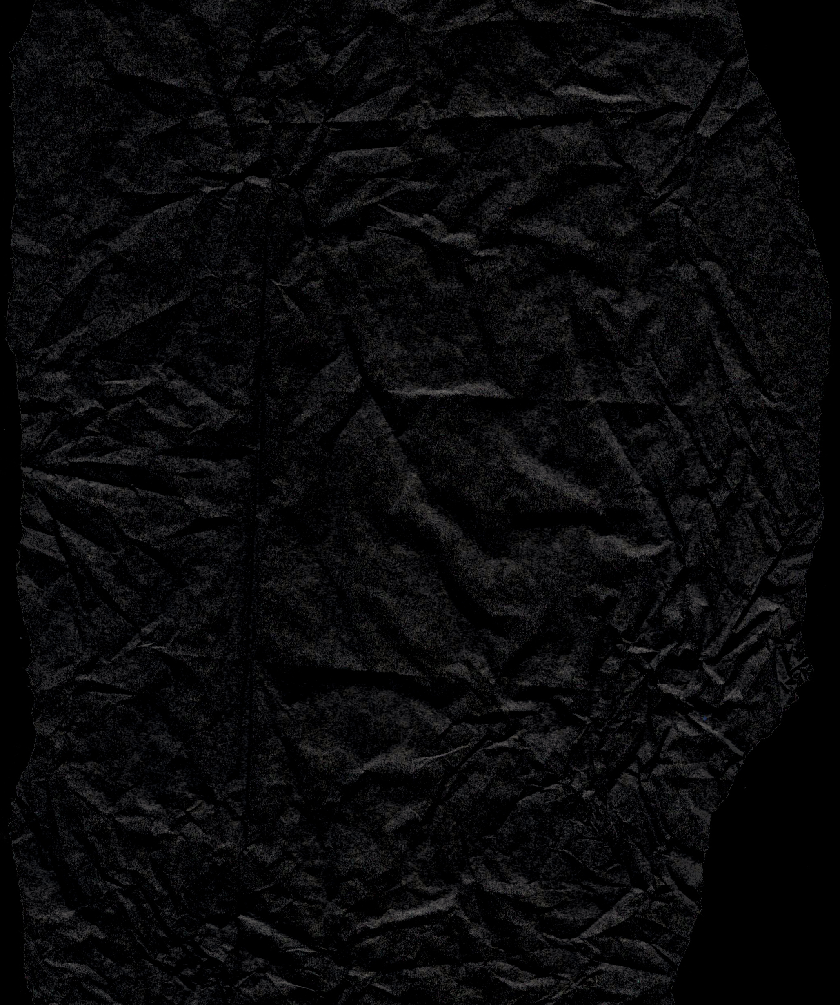






INTELLIGENT MONITORING SYSTEM
for soldiers

Slide 2



PROJECT OVERVIEW
Aim to develop a real-time health monitoring and location tracking system for soldiers in battlefield scenarios.
Hardware overview, including Arduino MEGA, various sensors (heart rate, temperature, etc.), GPS module, ZigBee, LoRaWAN, and more.
Enhanced safety for soldiers through continuous health monitoring.
Improved communication and coordination between soldiers and control units.

Slide 3



PROJECT GOALS
The goal of this project is to develop an integrated health monitoring and location tracking system for soldiers, utilizing biomedical sensors, GPS technology, and advanced communication modules. By seamlessly collecting and analyzing real-time health data, the system aims to enhance the safety of soldiers in battlefield scenarios. The incorporation of machine learning algorithms further enables insightful data clustering, aiding control units in timely decision-making. Ultimately, the project seeks to provide a robust, lightweight solution for improving the overall coordination and responsiveness of military operations.

Slide 4



PROJECT TIMELINE
 | WEEK 1-2 | WEEK 3-5 | WEEK 6-9 | WEEK 10-12+
TASK NAME | project scope | Begin research on mL algorithms | initial prototype | Implement ZigBee with GPS module
TASK NAME | Research on Existing system | finalize hardware component | Implement initial versions data collection for machine learning algorithm | Cloud Integration and Data Analysis
TASK NAME | Develop a detailed project plan | plan for software development and integration | Integrate biomedical sensors | Documentation and Presentation Preparation and final testing

Slide 5





BACKGROUND
GENERAL OVERVIEW
HISTORY
Improve coordination and responsiveness of army control units by minimizing search and rescue efforts.
Comprehensive system architecture designed to provide soldiers' real-time health status, location, and potential threats.
The historical context of health monitoring can be traced back to the development and popularization of wearable technology, which gained momentum in the late 20th century. Devices like heart rate monitors and many more

Slide 6



PROCESS
STEP 1
STEP 2
STEP 3
System Development and Integration
Project Planning and Research
Hardware Integration and Prototyping
Sensor Integration and Data Transmission
Machine Learning Algorithm Development
Algorithm Research and Selection
Algorithm Testing and Optimization
System Testing, Analysis, and Documentation
Comprehensive System Testing
Cloud Integration and Data Analysis
Documentation and Finalization
Final Testing and Presentation

Slide 7



HARDWARE & SOFTWARE REQUIRED
• Arduino MEGA 2560 • Heartbeat Sensor
• Temperature Sensor and Humidity Sensor (DHT11)
• Accelerometer (ADXL335) • Ethernet Shield (W5100)
• GPS Module (NEO-6M) • ZigBee Module (XB Series 1)
• LoRaWAN Module • ECG Module (AD8232 i.e. Electro-Cardiogram
HARDWARE
Embedded C / Python
Machine Learning algorithm for DATA ASSIGNMENT & CENTROID UPDATE
SOFTWARE

Slide 8



RESOURCES
Link 1 :
P.S. Kurhe, S.S. Agrawal (2013) “Real Time Tracking and Health Monitoring System of Remote Soldier Using ARM 7”, International Journal of Engineering Trends and Technology, 4(3), pp: (311-315).
Link 2 :
Shruti Nikam, Supriya Patil, Prajkta Powar, V. S. Bendre (2013) “GPS Based Soldier Tracking and Health Indication System” International Journal of Advanced Research in Electrical, Electronics and Instrumentation Engineering, 2(3), pp: (1082-1088).
Link 3 :
Akshita V. Armarkar, Deepika J. Punekar, Mrunali V. Kapse, Sweta Kumari, Jayshree A. Shelke (2017) “Soldier Health and Position Tracking System” IJESC, 7(3).

Slide 9

CONCLUSION
The "Real-time Health Monitoring and Location Tracking System for Soldiers" stands as a testament to the commitment to advancing the safety, effectiveness, and coordination of military operations through cutting-edge technology. This project not only addresses current challenges but also paves the way for a future where the well-being of soldiers remains at the forefront of technological innovation.
Through the integration of wearable sensors, soldiers' health parameters are continuously monitored, allowing for early detection of potential issues and enabling timely intervention. The incorporation of GPS technology facilitates precise location tracking, minimizing response times during critical situations. The system's ability to wirelessly transmit data between soldiers, leaders, and control units enhances communication in environments where traditional methods may fall short.
The utilization of machine learning algorithms adds a layer of intelligence to the project, enabling data clustering for insightful analysis.

Slide 10



MEET THE GROUP
Ambika
Rahul Raj
Raju kumar

Slide 11


THANK YOU

